Slide 1
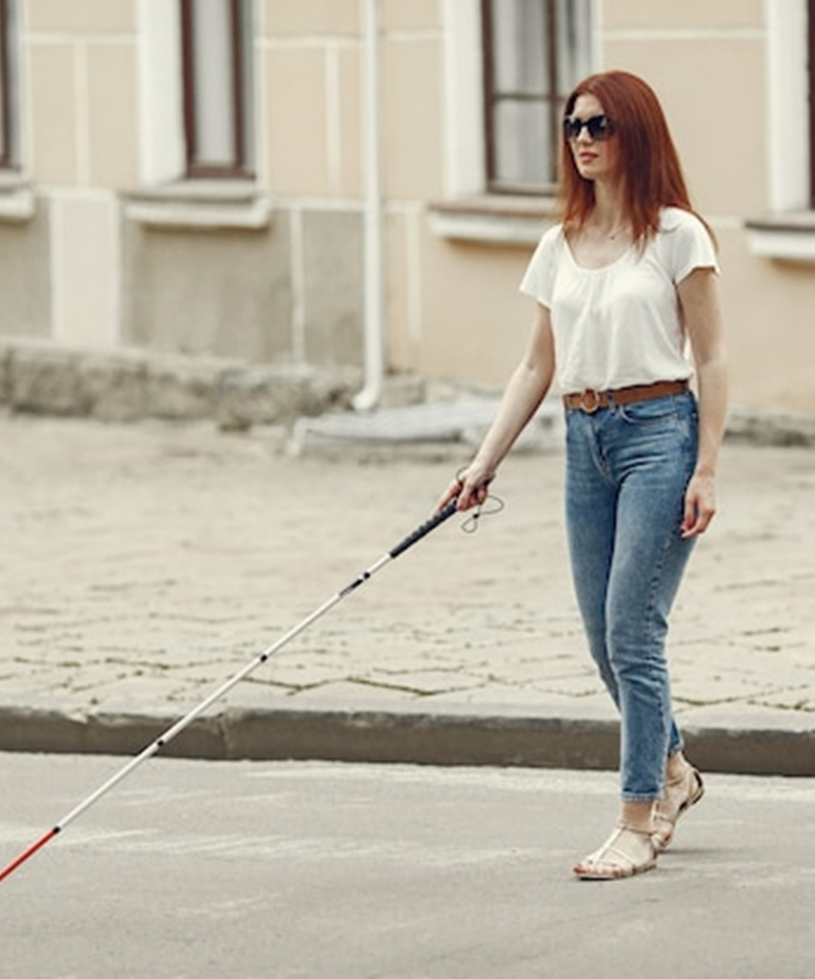
Smart Blind Stick
Ensuring Safety in Every Step

Slide 2

Our Team
01
02
03
04
05
06
07
08
09
Fizza (HEAD)
Rabel
Khushboo
Mehvish
Ali Sahito
Adeel
Rafay
Zunair
Nadeem
Ali Lashari
Shoaib
22AI-45
22AI-27
22AI-24
22AI-51
22AI-17
22AI-16
22AI-50
22AI-34
22AI-11
22AI-30
22AI-55

Slide 3
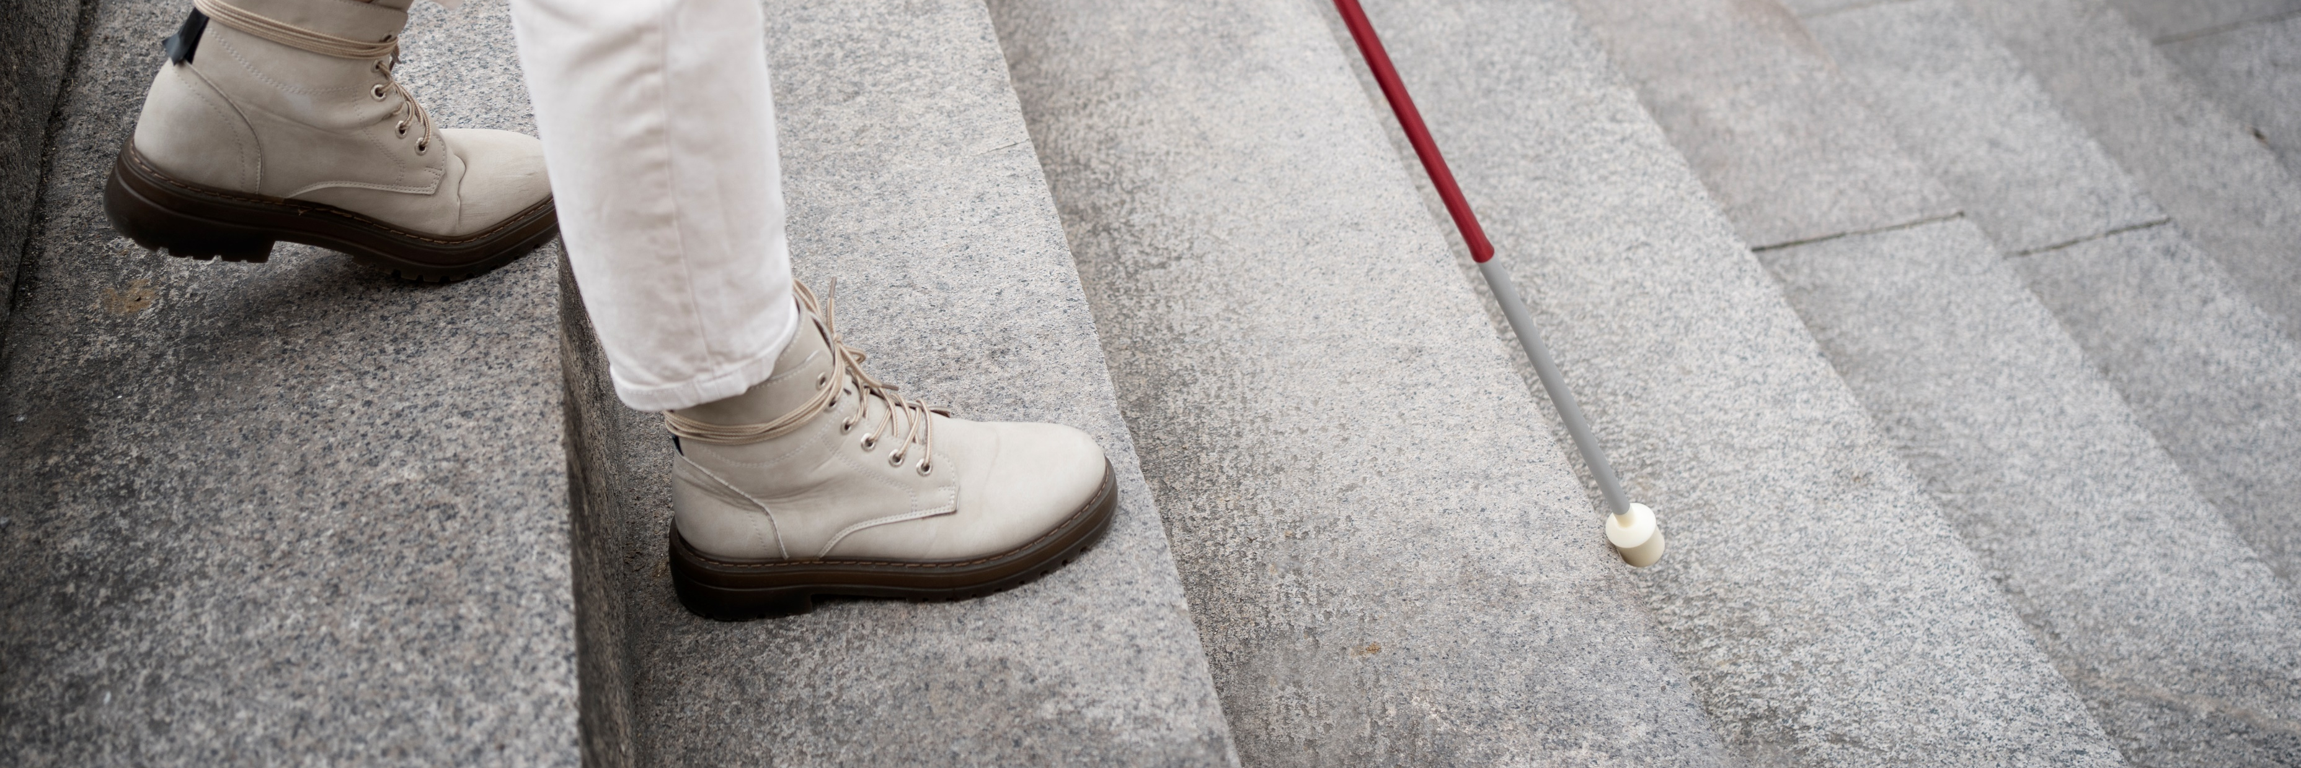
Abstract
We made a special stick for blind people to help them walk safely. The stick has a sensor that detects things in front of them and warns them with a sound and vibrator. It also detects water. The stick is controlled by a small computer called Arduino UNO. This stick helps blind people move around easily and safely. It's easy to carry and use. We plan to add more features like voice warnings to make it even better.

Slide 4
Table Of Content
01
02
03
04
05
06
07
08
Problem
Solution
Hardware
Software
Methodology
Future work
Advantages
Conclusion

Slide 5




The Problem
Daily Challenges
Limitations of White Canes
People who are blind or have low vision often face difficulties moving around independently.
Can only detect nearby obstacles.
Current Tools
Limitations of Guide Dogs
White canes and guide dogs are commonly used, but they have limitations.
Require extensive training, care, and can't detect certain hazards like water or mud.

Slide 6
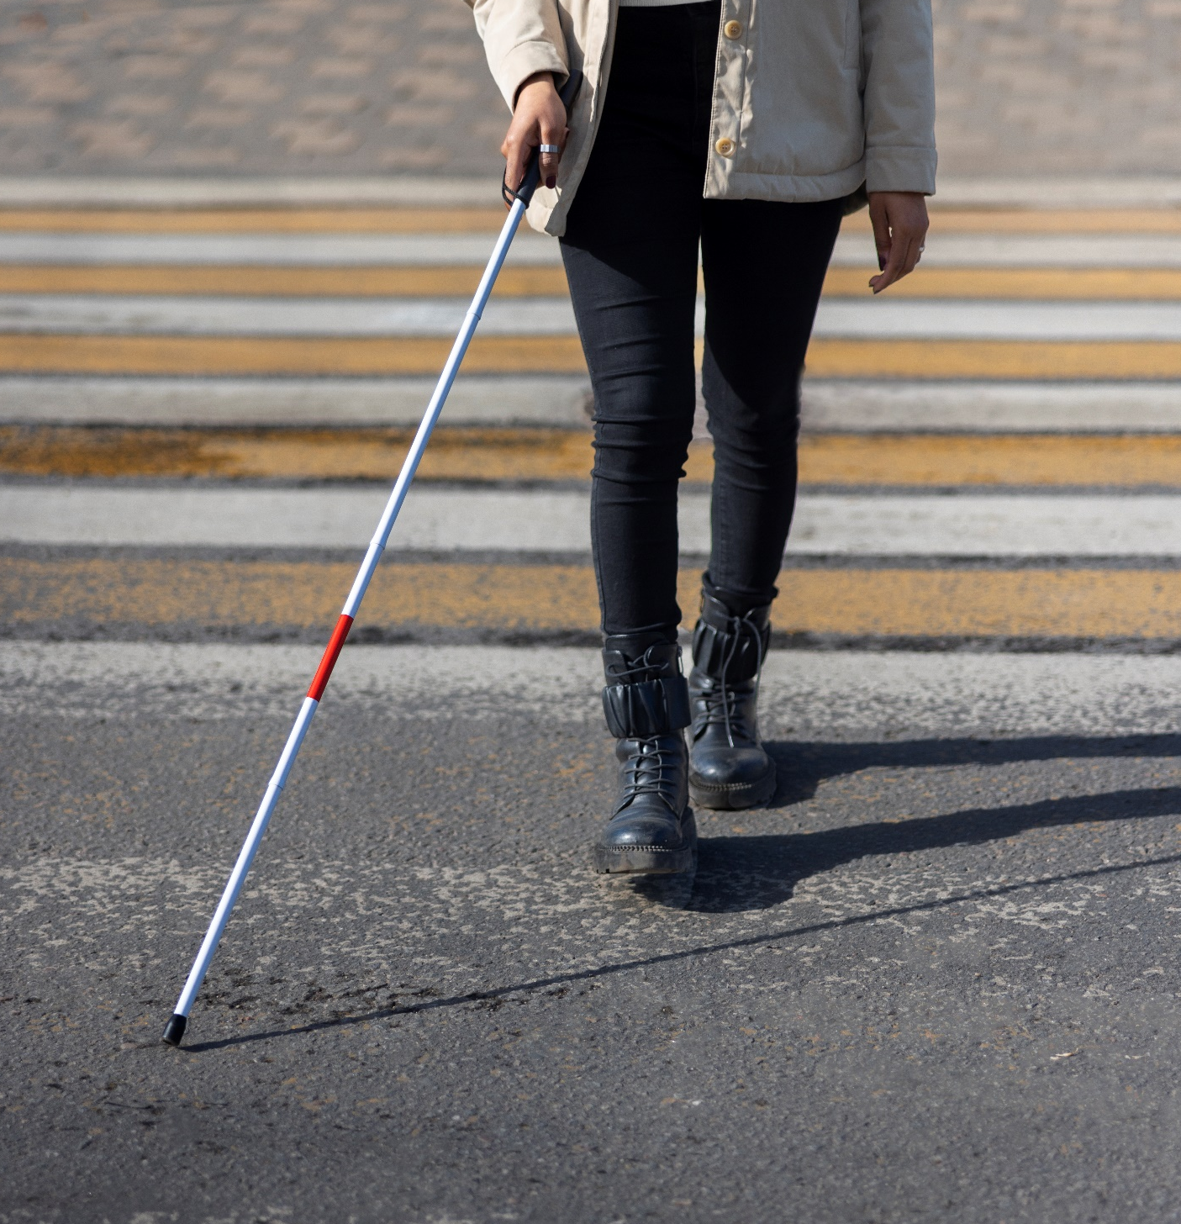



The Solution
Smart blind stick
Developed to enhance navigation and safety for blind individuals.
Technology Used
Utilizes an Arduino UNO to detect obstacles and water.
User Alerts
Warns users with sounds and vibrator to enhance their independence and safety.

Slide 7
Methodology
System design
The Smart Blind Stick uses an Arduino UNO to help visually impaired users navigate.
Software Development
Developed in Arduino IDE with C++, the software processes sensor data and controls outputs for timely, accurate responses.
2
0
0
2
1
0
04
3
Hardware
The stick includes an Arduino UNO, Sensors, Vibrator, a buzzer and a 9V battery, ensuring safe and effective use.
Testing and Calibration
Testing includes component, integration, and field testing to ensure reliable and effective obstacle detection.
5: Future Enhancement:=> Development of a lightweight and more ergonomic design for increased portability and comfort.=> Computer vision like (Integration of AI algorithms for more advanced obstacle detection and recognition.)=> Implementation of GPS technology for precise location tracking and navigation assistance.=> Integration with smartphone apps for enhanced functionality and remote monitoring by caregivers.

Slide 8
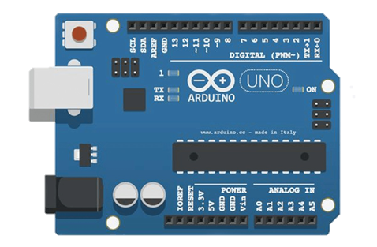
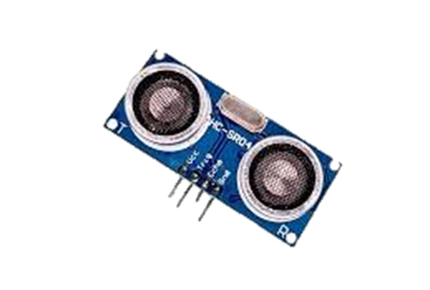
Hardware
Arduino UNO
HC-SR04 Ultrasonic Sensor
The Arduino UNO is a microcontroller board that acts as the brain of the project, responsible for processing sensor data, running programming logic, and controlling the stick's functions. It reads sensor inputs, makes decisions based on the programming, and outputs commands to other components
The HC-SR04 Ultrasonic Sensor detects obstacles and measures distance by sending ultrasonic waves and calculating the time it takes for them to bounce back. It sends out high-frequency sound waves, listens for the echoes, and uses the time delay to calculate the distance to obstacles.

Slide 9
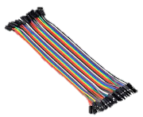
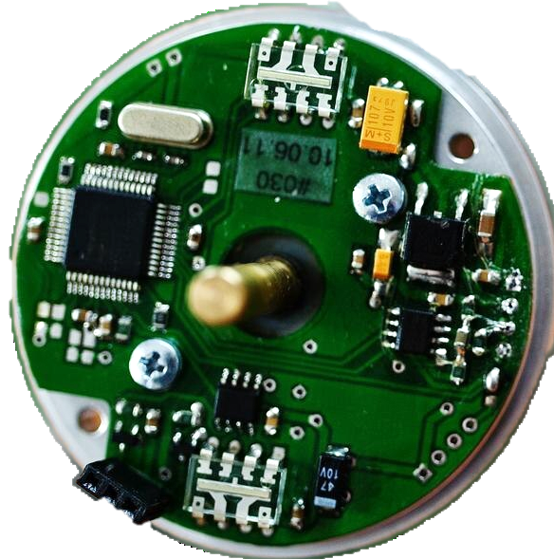
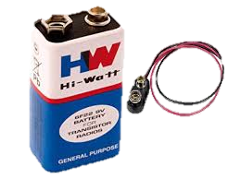
Hardware
Jumper wires
DC - buzzer
Battery & connector
Jumper wires are used to connect components to the Arduino UNO board, allowing for easy connections and disconnections. They provide a flexible and modular way to build the circuit, making it easy to add or remove components as needed.
The DC Buzzer produces a warning sound when obstacles are detected, alerting the user. When the Arduino UNO sends a signal to the buzzer, it vibrates a small metal diaphragm, producing a loud and clear sound.
The battery connector and 9V battery power the entire system, providing electricity to all components. The battery connector ensures a secure connection, and the rechargeable battery provides a reliable source of power.

Slide 10
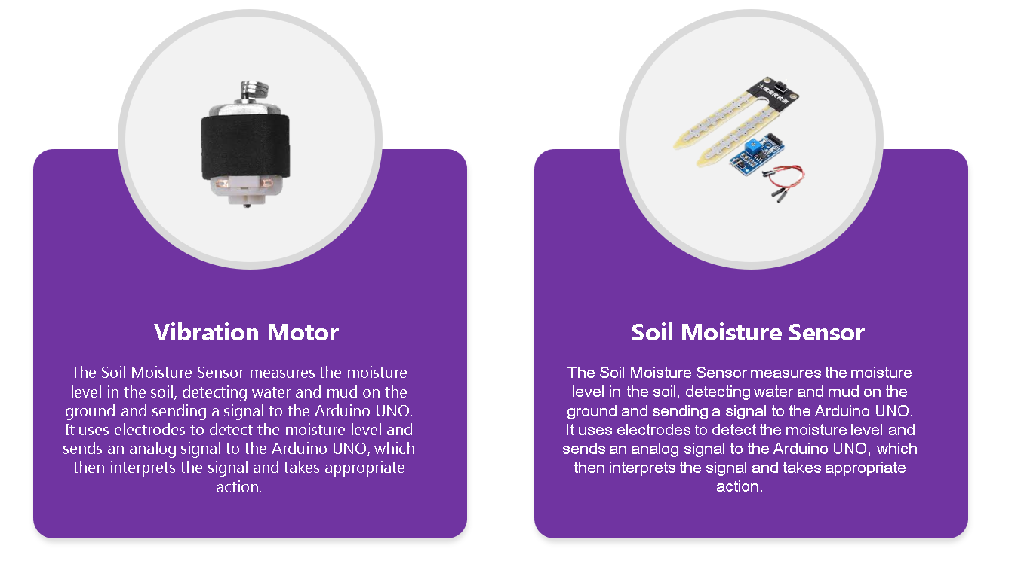
Hardware

Slide 11
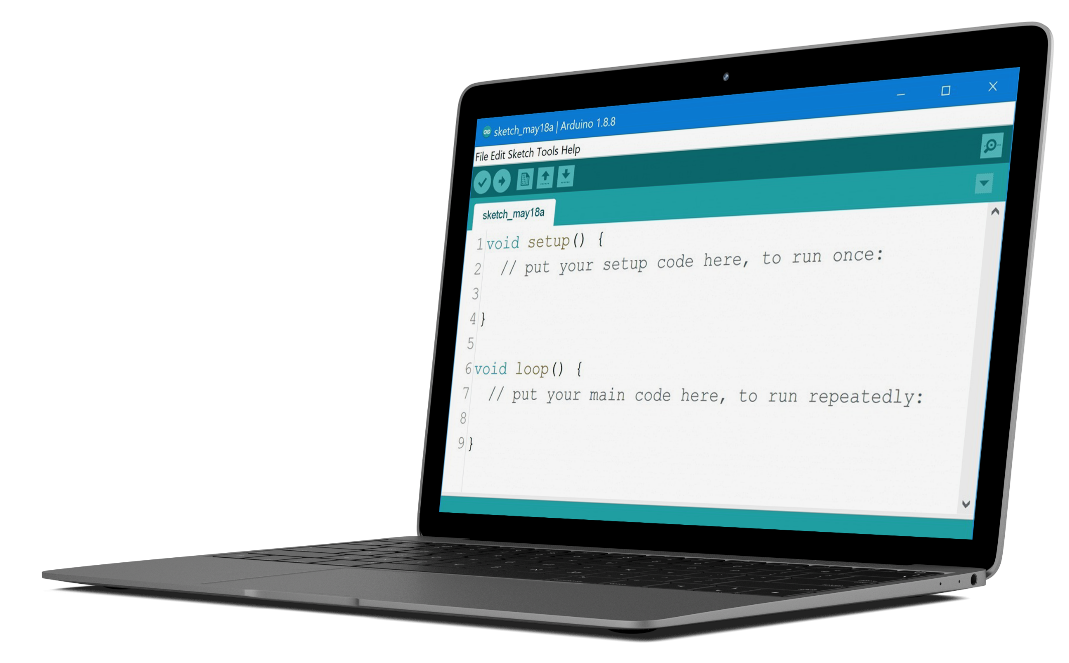



Software
The Arduino IDE software is a programming environment that allows us to write and upload code to the Arduino UNO board. In this project, it reads sensor data from the HC-SR04 Ultrasonic Sensor and Soil Moisture Sensor, processing this data to detect obstacles, water, and mud.
The software also controls the Servo Motor, rotating the stick's tip to detect obstacles across a 180-degree arc. This dynamic movement enhances the stick's ability to navigate through spaces efficiently.
Additionally, the Arduino IDE software activates the DC Buzzer to alert users of obstacles and hazards, providing audible warnings. It also lights up the LED Diode for visual alerts. The code, written in C++, is uploaded to the Arduino UNO board, ensuring seamless operation of all components.
Enhanced Usability and Assistance
Adding the voice feature will make the Smart Blind Stick even more user-friendly for visually impaired individuals. This audio guidance will complement existing tactile and visual feedback, providing a comprehensive assistance system for better navigation.
Real-Time Spoken Instructions
The new setup will allow the Smart Blind Stick to deliver real-time spoken instructions and alerts. For instance, it can guide users around obstacles and warn about hazards like stairs or slippery surfaces, offering clear audio feedback for safer navigation.

Slide 12
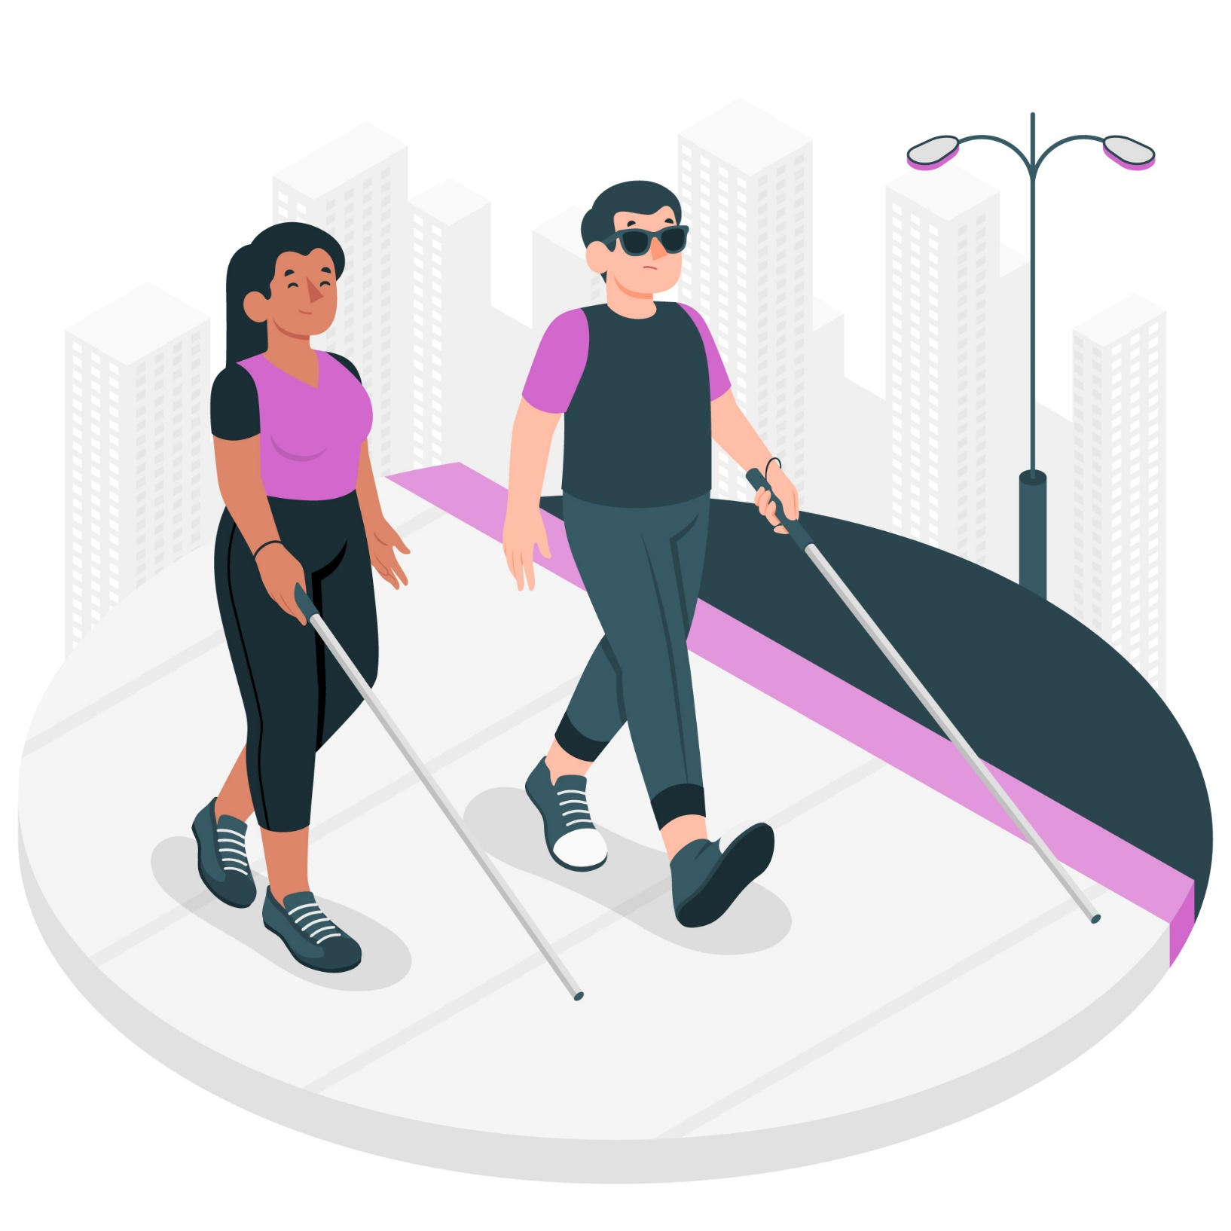
Future Work
Future Enhancements: Voice Guidance System
We plan to enhance the Smart Blind Stick by integrating a voice guidance system. This includes the JQ6500 16Mbit Voice Sound Board Module and a compact 20mm round 80ohm micro audio speaker. These additions will enable the stick to provide spoken instructions and alerts.
Commitment to Continuous Improvement
This upgrade demonstrates our commitment to improving the Smart Blind Stick's functionality and usability. By incorporating voice guidance, we aim to empower users with greater confidence and independence, enhancing their overall navigation experience.
Real-Time Spoken Instructions
The new setup will allow the Smart Blind Stick to deliver real-time spoken instructions and alerts. For instance, it can guide users around obstacles and warn about hazards like stairs or slippery surfaces, offering clear audio feedback for safer navigation.
Enhanced Usability and Assistance
Adding the voice feature will make the Smart Blind Stick even more user-friendly for visually impaired individuals. This audio guidance will complement existing tactile and visual feedback, providing a comprehensive assistance system for better navigation.

Slide 13
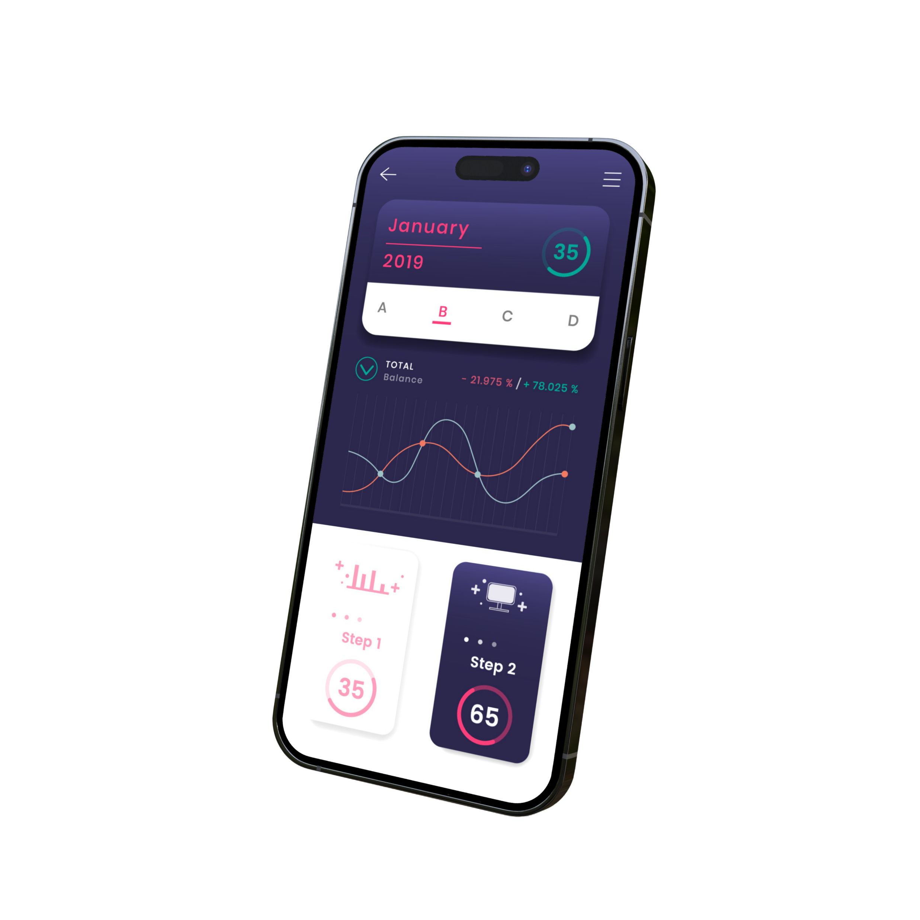



Advantages
Improving Quality of Life
The Smart Blind Stick empowers blind individuals by enhancing their confidence and independence. Utilizing modern technology, it improves walking safety and quality of life, making it an invaluable tool for safer and easier navigation.
Cost-Effective and Immediate Feedback
The Smart Blind Stick is an affordable tool that provides instant feedback about obstacles and hazards. Despite its lower cost, it offers high functionality with advanced sensors that detect obstacles, water, and mud, ensuring comprehensive safety for the user.
Enhancing Mobility and Independence
The Smart Blind Stick helps blind individuals move more easily and independently by warning them of obstacles and hazards, increasing safety, and reducing reliance on others. It detects water and mud, preventing slips and falls. Its user-friendly design requires minimal training, and it's lightweight and easy to carry.

Slide 14

Conclusion
To sum up, the Smart Blind Stick is a big help for people who can't see well. It uses special technology to find things in their way, like obstacles, water, and mud. This stick is easy to use and carry around, and it doesn't cost too much.
In the future, we're planning to make it even better by adding a voice system. This will let the stick talk to users, giving them directions and warnings as they walk.
Overall, the Smart Blind Stick gives people who can't see well more confidence to move around by themselves. It's a useful tool that helps them stay safe and independent in their daily lives.

Slide 15
THANK YOU

